Slide 1
Battle Engine: every design choice, and how to defend it
SYSTEM DESIGN · EXAM ASSIGNMENT 1 · DEFENCE PREP
Your TD1 exactly as submitted (34 pages), explained layer by layer, with the questions you can expect tomorrow and an answer for each.
Rokas Pazera · 551495 · prepared 5 November 2026
Notes:
How to use this deck: tonight, go through it once from top to bottom. Every slide has speaker notes with a short answer you can say out loud. Then do the defence drill (slides 46 to 54) twice, out loud. Tomorrow morning, read only slides 3, 4, 47, 48 and 53.

Slide 2
What tomorrow looks like, and what earns points
START HERE
Rubric criteria that EA1 is judged on (55 of 85 points)
The format
Criterion | What “excellent” says
C4 modeling · 20 | Applied correctly and consistently, the levels logically align with each other
UML modeling · 10 | Correct and consistent, and clearly shows structure and operation
Design and accountability · 25 | Logical and expandable; choices clearly substantiated; SOLID and patterns justified
20 to 30 minutes in total. First your 5 to 8 minute presentation (stopped at 10), then the defence: the lecturers ask about your designs, your decisions and the reasons behind them. They may ask you to open the TD and show details.
The questions (from the workbook)
“How did you arrive at this design?” · “Can you explain design choice X?” · “Which alternatives did you consider?”
So for every choice you name, give the reason and the alternative you rejected, and show that the layers use the same names from top to bottom.
“We assess not only the result, but also the design process.”
Notes:
The other two rubric rows (code analysis 15, refactoring 15) are about EA2. For EA1 the biggest block is design and accountability (25): that is exactly “reason plus rejected alternative”. Bring on the laptop: the TD1 PDF, the TD2 PDF, the EA2 code, your reflections and your presentation.

Slide 3
Your design in 60 seconds
START HERE · LEARN THIS BY HEART
The Battle Engine is a pure rules engine for one turn-based battle: 1 to 4 characters against 1 to 4 enemies. It knows nothing about networking, storage, the screen or the AI.
I designed it top-down with C4. Layer 1: the whole online game is one system, used by the Player, with one external Account Provider. Layer 2: five containers, driven by the case: always online, instances that start and stop, at most 8 players, no permanent data on an instance. Layer 3: inside the Game Instance, a Battle Coordinator owns the turn loop, the Human and AI controllers share one interface, and a Broadcaster decorates the engine to push updates. Layer 4: one facade object per battle, the interface split in two for the two kinds of callers, effects and rules as small interchangeable objects, and snapshots so nothing can change a battle outside the rules.
Notes:
Say this almost word for word when they ask “Tell us about your design” or “Explain EA1”. It touches every layer in one breath and hints at the patterns (facade, strategy, decorator) and the principles (ISP, OCP, SRP), which invites the questions you are best prepared for.

Slide 4
Five ideas explain almost every choice you made
START HERE · THE MENTAL MODEL
1
A pure rules engine
No network, storage, UI or AI inside. So: the Coordinator saves results, the Broadcaster pushes updates, controllers choose actions, battle-engine.jar depends on no other jar.
2
The server is the authority
The client sends only ids (actionId, casterId, targetIds). Damage, healing and percentages always come from the engine’s own ActionDefinition, so a modified client cannot cheat.
3
One battle, one engine object
nextTurn() has no battleId, yet 8 players can fight at once. So: a BattleEngineFacade per battle, made by DefaultBattleEngineFactory, and no Singleton.
4
One place decides the turn
Only the Battle Coordinator calls startBattle and nextTurn. Controllers get only BattleActions, so the AI can never end the human’s turn (Interface Segregation).
5
Add, don’t change
New effect: new ActionEffect + register(). New rule: new ActionRule in the list. New controller: new BattleController. New event: new LogEntry subclass (Open/Closed).
Notes:
When you get a question you did not prepare, map it to one of these five ideas first. Example: “Why can’t the client send the damage value?” is idea 2. “Why is there a Battle Coordinator?” is idea 4 plus idea 1. “Why so many small classes?” is idea 5.

Slide 5
Where everything is in your PDF
START HERE · NAVIGATION
§ | What | Page
1.1 | Goal | 4
1.2 | Interpretations, assumptions | 4-5
2.1 | System context diagram | 6
2.2 | Use case: Online Game System | 6-7
2.3 | Use case: Battle Engine as subject | 7-8
3.1 | Containers, table, technology | 8-10
3.2 | Deployment (layer 2), protocols | 10-11
3.3 | Component (layer 2), interfaces | 11-13
4.1 | C4 component diagram, table | 13-15
4.2 | UML component (layer 3) | 15-16
4.3 | Deployment (layer 3), artifacts | 16-17
5.1 | Package overview | 18-19
§ | What | Page
5.2 | Interface and facade | 19
5.3 | Battle model, snapshot | 20-21
5.4 | Actions and effects | 21
5.5 | Validation, rules table | 21-22
5.6 | Configuration and factories | 22-23
5.7 | Battle log, example log | 23-24
6.1 | SOLID principles | 25-26
6.2 | Design patterns | 26-27
7.1 | Design process | 27-28
7.2 | Design decisions (13 rows) | 28-30
7.3 | Trade-offs | 30
8 | Sources, “used in” table | 31-34
Notes:
Page numbers are the ones the PDF viewer shows (title page = 1). The table of contents inside your PDF is off by one or two pages, so navigate by these numbers or by the section number. Every figure sits right after its text, often on the next page. If a lecturer asks “show me where you justify X”, the answer is almost always 7.2 (decisions table) or 6.2 (patterns table).

Slide 6
The case, and what handles each rule
THE CASE
Case rule | Your answer
Always online; a player always plays on one instance | Game Instance container; the client connects to it over WebSocket
Playing alone starts a new private instance | Instance Manager: requestOwnWorld(token) starts a Game Instance container
Visiting = switching to another player’s instance | requestVisit(token, ownerPlayerId) returns the address of the owner’s instance
At most 8 players per instance | Instance Manager checks before routing, Player Session Manager enforces on join, maxPlayers = 8
An empty instance is shut down | Instance Agent reports the player count; stop after emptyShutdownSeconds = 30
No permanent data on an instance | Persistence Service + PostgreSQL; the Player Data Client writes every change through
The player installs a client | Game Client (Java 21 + jMonkeyEngine) on the Player PC
1-4 characters vs 1-4 enemies, never PvP or co-op | ConfigBattle with 1-4 units per side; a Battle has exactly 2 BattlePlayers (HUMAN, COMPUTER)
Notes:
The case also says: Dragon Quest XI as inspiration, the game has many other parts (3D models, audio, quests, world map, navigation, equipment) but you focus on the Battle Engine. If they ask “where is requirement X handled?”, answer with the component first, then the mechanism. Example: “Max 8 players: the Instance Manager checks its registry before it sends a visitor, and the instance checks again on join, because two visitors can be routed at the same moment.”

Slide 7
The six methods and who calls them
THE CASE · THE GIVEN INTERFACE
Given in the case | Your Java signature | In interface | Called by
StartBattle(ConfigBattle) | void startBattle(ConfigBattle config) | BattleLifecycle | Battle Coordinator
GetBattleState() | Battle getBattleState() | both halves | Coordinator, AI controller
GetAvailableActions(unitId) | List<Action> getAvailableActions(int unitId) | BattleActions | Human and AI controller
ApplyAction(int unitId, Action) | void applyAction(int unitId, Action action) | BattleActions | Human and AI controller
NextTurn() | void nextTurn() | BattleLifecycle | Battle Coordinator only
GetBattleLog(battleId) | BattleLog getBattleLog(UUID battleId) | BattleLifecycle | Battle Coordinator
camelCase on purpose
Nothing is lost by the split
Your own types
Everything is Java 21, so Java naming: StartBattle becomes startBattle. Types and parameters are yours; the case lets you define them.
BattleEngine extends BattleActions and BattleLifecycle, so the full given interface still exists in one type.
Battle = a complete detached copy. Action = a request with ids. BattleLog = ordered entries with toText().
Notes:
Who calls what comes straight from your use case diagram 2.3: the Coordinator starts, passes the turn, reads the state and the log; the AI reads the state, asks for actions and applies one; the human controller asks for actions and applies one (it does not need to read the state, because the Broadcaster pushes the state to the client). getBattleState() sits in both interfaces: everyone may read.

Slide 8
The formulas, and where each one lives
THE CASE · RULES IN CODE
Rule | Lives in | Formula
Damage | DamageEffect.apply() | max(0, base + caster.power - target.defence)
Healing | HealEffect.apply() | base + caster.spirit
Max HP | Unit.heal() | hp = min(maxHp, hp + amount)
Knock-out | Unit.takeDamage(), ActionResolver | hp = max(0, hp - amount); at 0 the unit moves to knockedOutUnits
Stat ±X% | StatModifierEffect, Stats.applyPercentage() | new = ceil(old × (100 + p) / 100), never below 0; caster’s stats ignored
Turn | TurnManager.passTurn() | active = opponent of active; turnNumber + 1
Case examples, checked
10 + 4 - 6 = 8
10 + 4 - 1 = 13
15 + 6 = 21 (each target)
min(50, 40 + 20) = 50
8 × 1.25 = 10
1 × 1.25 = 1.25 → 2
own: 7 × 0.75 = 5.25 → 6
Round up with integers: (old × (100 + p) + 99) / 100, or Math.ceilDiv in Java 21. Floating point fails: 10 × 1.1 = 11.000000000000002, so ceil gives 12.
Notes:
Your PDF does not have a formula table (it was in your earlier draft), so be ready to say these out loud. Key points: damage is clamped at 0 so a high Defence never heals (your interpretation); HP is stored as 0, never negative, while the log shows the calculated damage; healing is capped at max HP (case example 40 + 20 becomes 50); a stat change ignores the caster’s stats (the case says so) and always rounds up, also for decreases; a stat never goes below 0. The single responsibility argument: if the damage formula changes, only DamageEffect changes.

Slide 9
Where the case was open, you decided
THE CASE · §1.2 INTERPRETATIONS (1 OF 2)
Open point | Your choice | Why
Who starts? | ConfigBattle.firstPlayer, default HUMAN | The case log starts with player 1 (Human); an ambush (computer first) needs no code change.
When does a battle end? | When all units of one side are knocked out: the other side wins. Then applyAction and nextTurn are refused. | The case defines no end. This is the usual RPG rule (Dragon Quest XI).
Actions per unit per turn? | No limit: the turn ends when nextTurn() is called. | The case sets no limit, and its example log shows unit A acting twice. A limit would be one new ActionRule.
Which units can be targeted? | Each action has a TargetType (ENEMY, ALLY, ANY) and a maxTargets. | Otherwise every action could hit every unit. It narrows “1..*” per action without breaking it.
Negative damage? | Clamped to 0. | Else a high Defence would heal the target, which contradicts “Defence reduces the damage”.
Notes:
The workbook allows your own interpretations “as long as they are motivated and do not contradict or override the given requirements”. Say that sentence if they challenge one: each of these only fills a gap. Strongest one to explain: no limit on actions per turn, because the case’s own example log shows unit A acting twice in one turn.

Slide 10
Four more, plus two you enforce silently
THE CASE · §1.2 INTERPRETATIONS (2 OF 2)
Open point | Your choice | Why
HP below 0? | Stored as 0, never negative; the log shows the calculated damage. | Keeps 0 ≤ hp ≤ maxHp true at all times.
Several battles on one instance? | One BattleEngineFacade object per battle. | Up to 8 players can fight at once, while nextTurn() and getBattleState() have no battleId.
Login? | An account at the external Account Provider. | The case does not describe login, but player data must belong to a known player.
Leaving during a battle? | The battle is abandoned, nothing is saved; no instance switch during a battle. | No half-finished battle ever has to be stored.
Not in your table, but in your design: know them
No self-targeting. The case says “1..* other units”; TargetSelectionRule rejects the caster as a target. Always round up (ceiling), also for decreases, and a stat never goes below 0: the case says “round up” and its example rounds 1.25 to 2.
Notes:
If they ask “can a unit heal itself?”: “Not in this design. The case says an action happens between the caster and 1..* other units, so the TargetSelectionRule rejects the caster. If the game designers want self-heal, that is a new TargetType value and a change to that one rule.” If they ask about disconnects: the Player Session Manager tells the Battle Coordinator, which abandons the battle; this is why no running battle is ever stored.

Slide 11
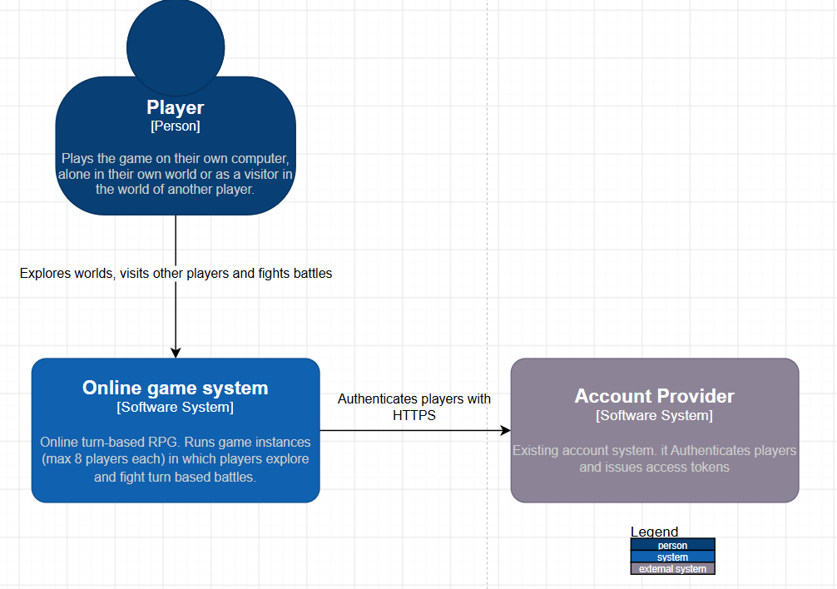
One system, one person, one external system
C4 LAYER 1 · CONTEXT · §2.1
The whole game is one software system. Instances, persistence and the engine are all inside the Online Game System; they appear from layer 2 on.
One person: the Player. Plays alone in their own world, or visits the world of another player.
One external system: the Account Provider. The studio’s existing account system. Login is shared with other games, so it is not yours to build.
The AI is not an actor here. It runs on your own servers, so at system level it is inside. “Outside the battle engine” in the case means outside the engine, not outside the game.
C4 basics shown: every arrow says what happens (plus HTTPS), and there is a legend.
Notes:
Say: “At layer 1 the whole online game is one software system. The Player is the only person and the existing Account Provider is the only external system, used to log in. The computer opponent is not an actor at this level: it runs on our servers, so it is part of the system. It only becomes an actor in the use case diagram where the Battle Engine itself is the subject.” Why is login external? The case does not describe login, but player data has to belong to a known player, and the studio already has an account system shared by its games.

Slide 12
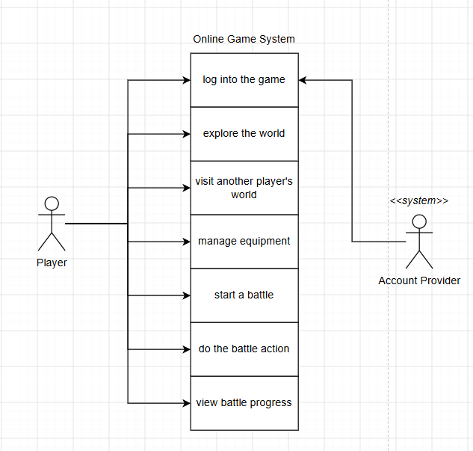
What the Player can do with the system
C4 LAYER 1 · UML USE CASE · §2.2
Seven player goals: log into the game, explore the world, visit another player’s world, manage equipment, start a battle, do a battle action, view battle progress. The Account Provider is a secondary «system» actor on log in.
Switching instances is not a use case. The player’s goal is to visit a world; switching instances is how the system achieves it.
“Start a battle” means, from the player’s view, running into enemies while exploring. The World Simulation detects the encounter (layer 3).
Notation check: expect this one
In UML a use case is an oval inside the system boundary, and an association is a plain line without arrowheads. Your figure stacks rectangles and uses arrows. Say so yourself: each box is one actor goal, so the content is right, the symbols are not.
Notes:
If they point at the rectangles: “You’re right, in UML 2.5 these should be ovals inside the system boundary, and the actor-use case links are plain associations, not arrows. I drew it as a list in draw.io for readability. The content is what I intended: each box is a goal of the Player, and the Account Provider takes part in logging in.” Do not argue that rectangles are fine. Show you know the rule. Your earlier draft even had a note about exactly this (“notation is part of the design”).

Slide 13
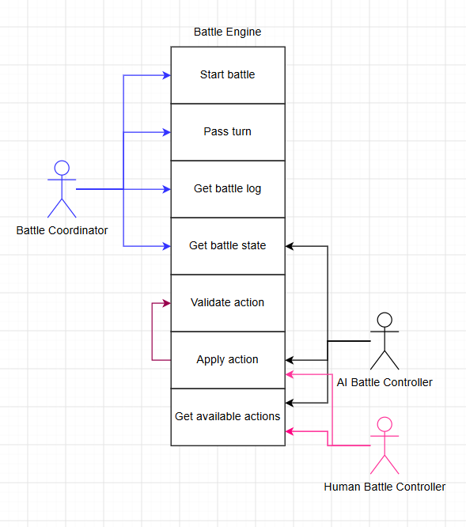
The Battle Engine as the subject
C4 LAYER 1 · UML USE CASE · §2.3
Seen from the engine, the other components of the Game Instance are actors and its six methods are the use cases. It shows where the engine is used, the workbook’s tip for layer 1.
Actor | Uses
Battle Coordinator | start battle, pass turn, get state, get log
AI Battle Controller | get state, get available actions, apply action
Human Battle Controller | get available actions, apply action
Apply action always includes Validate action: a rule-breaking action is rejected before anything changes.
Notation check
«include» is a dashed arrow from Apply action to Validate action, labelled «include». Yours is solid and unlabelled.
Notes:
Possible question: “Why are internal components actors?” Answer: an actor is any role outside the subject that interacts with it. When the subject is the Battle Engine, the Coordinator and the controllers are outside it, so they are actors. Possible question: “Why doesn’t the human controller read the state?” Answer: the Battle Broadcaster pushes every new state and log line to the client, so the human controller only needs the available actions and applyAction. Possible question: “Why include and not extend?” Validation happens every time, so it is «include»; «extend» is for behaviour that only happens under a condition.

Slide 14
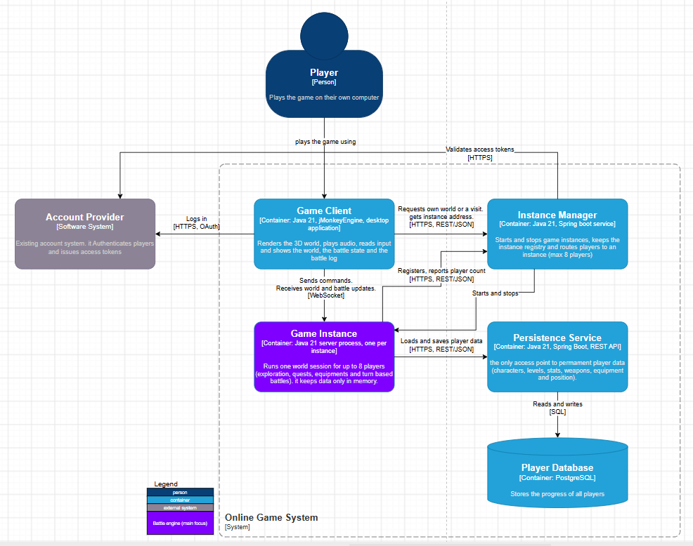
Five containers, shaped by the case
C4 LAYER 2 · CONTAINER · §3.1
Game Client · Java 21 + jMonkeyEngine. Renders world and battles, reads input, sends commands.
Instance Manager · Spring Boot. Starts and stops instances, keeps the registry, routes players, max 8.
Game Instance (purple) · one Java process per instance. One world session for up to 8 players, memory only. Runs the Battle Engine.
Persistence Service · Spring Boot REST. The only access point to permanent player data.
Player Database · PostgreSQL. Characters, levels, stats, weapons, equipment, position.
A C4 container runs or stores data on its own (app, service, database), not a Docker container. Purple marks what the next layer zooms into.
Notes:
Say: “Layer 2 splits the system by how the game is played: always online, instances that start and stop, at most eight players, and no permanent data on an instance. That gives five containers. The Game Instance, in purple, runs the Battle Engine and keeps data only in memory.” The table in 3.1 gives each container a column “Why a separate container”: Game Client because the case requires an installed client; Instance Manager because instances come and go and something longer-lived must know which exist; Game Instance because each must start and stop on its own; Persistence Service because no permanent data may live on an instance and all instances must see the same current data; Player Database because the data is relational and needs transactions.

Slide 15
Why five containers, and what you rejected
C4 LAYER 2 · DECISIONS · §3.1, §7.2
Decision | Rejected alternative | Why
Instance Manager is its own container | Clients connect straight to a known instance address | One part must see all instances: enforce max 8, start private instances, stop empty ones.
Persistence Service is its own container | Every instance writes to the database itself | Else every instance needs DB credentials and schema knowledge; a schema change hits all of them.
Battle Engine is a library in the Game Instance | A separate battle service | A battle lives in memory on one instance; a service adds a network call per action.
One container per instance, auto-scaled servers | Several instances in one server process | A crash stays inside one instance; stopping an instance = removing its container.
Database on its own server | Database on a shared machine | The only permanent data gets its own machine with backups, apart from stateless services.
Pattern for every answer: “I chose X. I considered Y, but Y would mean Z.” These five rows are your best layer-2 examples.
Notes:
Practise each row as one sentence. Example: “Persistence is a separate service. I considered letting every instance write to the database directly, but then every instance needs credentials and knowledge of the schema, and every schema change affects all instances. With one access point, reading and writing player data happens in one place.” For the Battle Engine: “A battle belongs to one game instance and only lives in memory, so a separate service would add a network call for every action and gain nothing.”

Slide 16
Technology and protocol choices
C4 LAYER 2 · TECHNOLOGY · §3.1, §3.2
Technology
Protocols
Java 21 everywhere. Long-term support and the course language. Client and server share data classes (Battle, Action) for the network messages.
WebSocket (TLS), client to instance. One long-lived two-way connection: the server pushes other players’ moves and the computer’s battle actions. Works through firewalls. Rejected: HTTP polling (delay, wasted calls) and UDP (a turn-based battle needs no extra speed).
jMonkeyEngine for the client: a 3D game engine for Java. The installer bundles the Java runtime, so the player installs nothing else.
Spring Boot for the REST services: Instance Manager and Persistence Service.
HTTPS + REST/JSON to the Instance Manager and Persistence Service: short request-response calls, simple and easy to monitor.
PostgreSQL: relational data (player, characters, items) that needs transactions.
SQL: only the Persistence Service talks to the database.
OAuth over HTTPS: the client logs in at the Account Provider; the access token is then checked by the Instance Manager and, on join, by the Session Gateway.
Changed in v1.1: C#/.NET with Unity became Java 21, the language of the course.
Notes:
Likely question: “Why not one technology per job, for example C++ for the client?” Answer: one language means the client and server share the same data classes for messages, and Java is what the course uses, so the design can be built with the course’s knowledge and tools. Likely question: “How does the Game Instance check a token if it does not require AuthenticationApi?” A good answer: the access token is a signed token from OAuth, so the Session Gateway can verify its signature locally with the provider’s public key; no call is needed. (This detail is not in your PDF, so say it as how you would implement it.)

Slide 17
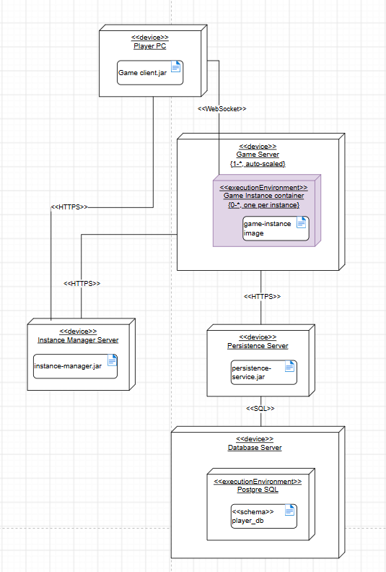
Where the containers run
C4 LAYER 2 · UML DEPLOYMENT · §3.2
«device» = a machine: Player PC, Game Server, Instance Manager Server, Persistence Server, Database Server.
Game Server {1..*, auto-scaled}: cloud VMs, added and removed as the number of instances changes.
«executionEnvironment» Game Instance container {0..*, one per instance}: a crash stays inside one instance; stopping = removing the container.
Communication paths carry the protocol: «WebSocket», «HTTPS», «SQL». The Account Provider is not shown: it is external, you don’t deploy it.
Container (C4) | Node | Artifact
Game Client | Player PC | game-client.jar
Instance Manager | Instance Manager Server | instance-manager.jar
Game Instance | Game Server, container | game-instance image
Persistence Service | Persistence Server | persistence-service.jar
Player Database | Database Server | «schema» player_db
Notes:
The table is your consistency argument for the C4 rubric row: every container of the C4 diagram appears as exactly one artifact on one node, with the same name. Say: “The deployment diagram shows one container per instance on auto-scaled game servers, so a crashing instance cannot affect another one. The database gets its own server because it is the only place with permanent data.” Notation: device = hardware or VM, executionEnvironment = software that hosts other software (a container runtime, PostgreSQL), artifact = a deployable file (jar, image, schema), multiplicity in braces.

Slide 18
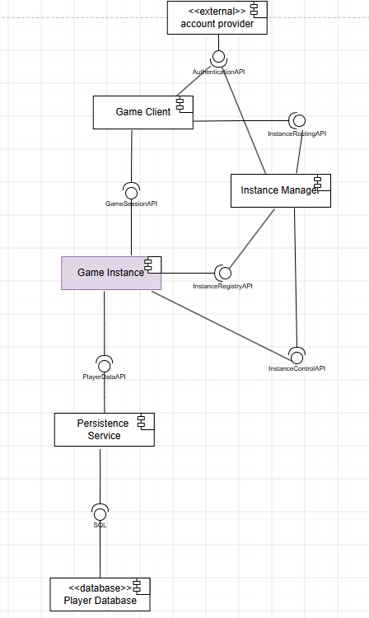
The interfaces between the containers
C4 LAYER 2 · UML COMPONENT · §3.3
Ball (lollipop) = provided interface · socket = required interface · container interfaces end in “Api”.
Interface | Provider → user | Main operations
AuthenticationApi | Account Provider → Game Client, Instance Manager | login (OAuth), validateToken(token)
InstanceRoutingApi | Instance Manager → Game Client | requestOwnWorld(token), requestVisit(token, ownerPlayerId)
InstanceRegistryApi | Instance Manager → Game Instance | register(instanceId, address), reportStatus(instanceId, playerCount)
InstanceControlApi | Game Instance → Instance Manager | shutdown()
GameSessionApi | Game Instance → Game Client | join(token), sendCommand(cmd); pushes WorldUpdate and BattleUpdate
PlayerDataApi | Persistence Service → Game Instance | getPlayer, saveCharacter, saveInventory, savePosition
Notes:
Plus SQL: provided by the Player Database, required by the Persistence Service. Two directions are worth explaining: the Game Instance requires InstanceRegistryApi (it registers itself and reports its player count), and the Instance Manager requires InstanceControlApi (to shut an instance down). Consistency to point out: InstanceControlApi, InstanceRegistryApi and PlayerDataApi appear again in the layer-3 component diagram on the Instance Agent and the Player Data Client, with the same names.

Slide 19
How the instance rules work at runtime
C4 LAYER 2 · RUNTIME BEHAVIOUR
1 Own world
2 Visit
requestOwnWorld(token): the Instance Manager starts a new Game Instance container, or returns the running one. It waits until the instance has called register() and returns its address.
requestVisit(token, ownerPlayerId): the owner’s instance must run and have fewer than 8 players. The instance checks again on join(token), because two visitors can be routed at the same moment.
3 Shut down when empty
4 Nothing is lost
Every join and leave is reported (reportStatus). After 0 players for 30 s (emptyShutdownSeconds), the Instance Manager calls shutdown(). The delay avoids a restart when someone reconnects.
Player data is written through to the Persistence Service the moment it changes. On leave only the position is saved, so removing the container loses nothing.
This flow was a sequence diagram in your earlier draft, not in the final PDF. Your interfaces (§3.3) and instance-config.json (§4.3) fully support it, so explain it in words.
Notes:
Likely question: “How does visiting another player’s world work?” Walk through cards 2 and 3. The double check on the 8-player limit is a nice detail: it shows you thought about two requests arriving at the same time (a race condition). Likely question: “What if the player reconnects after a network glitch?” The 30-second delay keeps the instance alive, so it does not have to restart.

Slide 20
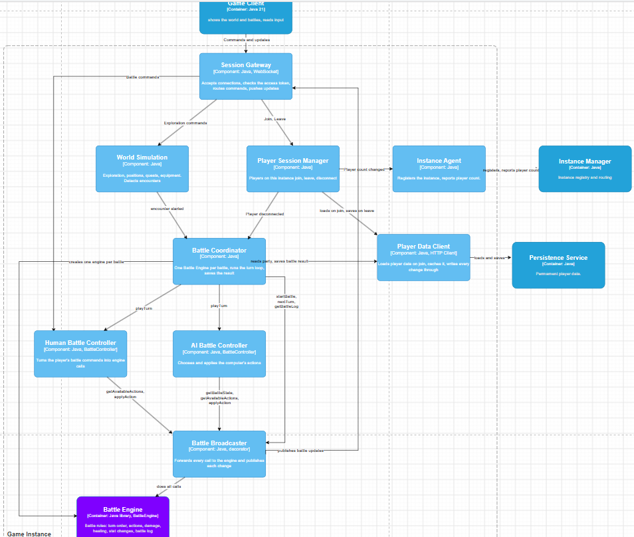
Inside the Game Instance: ten components
C4 LAYER 3 · COMPONENT · §4.1
Grouped by the jar that holds them (§4.3)
host: Session Gateway (WebSocket in, checks the access token, routes commands, pushes updates) · Player Session Manager (max 8; join, leave, disconnect) · Instance Agent (registers, reports count, shuts down)
world: World Simulation (exploration, quests, equipment; detects encounters)
battle: Battle Coordinator · Human Battle Controller · AI Battle Controller · Battle Broadcaster
battle-engine.jar: the Battle Engine, purple, zoomed into at layer 4
data: Player Data Client (loads on join, keeps data in memory, writes every change through)
Label check: the engine box says “[Container: Java library]”. At this layer it is a component.
Notes:
Say: “Layer 3 zooms in on the Game Instance and shows who uses the engine: who starts a battle, who chooses actions, who passes the turn, and how results reach the client and the Persistence Service.” The other components exist to explain the engine’s context: the workbook says to focus on the Battle Engine at the deeper layers, so the world, quests and equipment stay one box (World Simulation). If they ask about the engine’s label: “It should say Component. It is a component of the Game Instance that is deployed as a library jar, battle-engine.jar.”

Slide 21
The three big layer-3 decisions
C4 LAYER 3 · THE DECISIONS THAT MATTER MOST
The Coordinator owns the turn loop
One BattleController, two players
The Broadcaster is a Decorator
What: only the Battle Coordinator calls startBattle and nextTurn, and it saves the result.
What: Human and AI Battle Controller both provide BattleController. The Coordinator lets the active player’s controller play the turn.
What: it implements BattleActions and BattleLifecycle, wraps the engine, forwards every call, then pushes state and log lines to the client.
Why: one place decides about turns, so the AI can never pass the human player’s turn by mistake. The engine stays a rules engine without storage.
Why: both players are treated the same; an auto-battle controller is a new class, no Coordinator change. Strategy.
Why: the engine stays free of networking (SRP); otherwise three callers would each send updates.
Rejected: an if/else on the player kind in the Coordinator.
Rejected: controllers call nextTurn() themselves; the engine saves results itself.
Rejected: the engine sends updates itself.
Notes:
These three are the heart of your presentation slide 5. Say: “Three decisions matter here. One: the Battle Coordinator owns the turn loop. Only it starts a battle, passes the turn and saves the result, so the AI can never pass the turn of the human player. Two: the human and the AI controller provide the same BattleController interface, so the coordinator treats both players the same way. Three: the Battle Broadcaster is a decorator around the engine. It sends every new state to the client, so the engine itself knows nothing about networking.”

Slide 22
More layer-3 choices to justify
C4 LAYER 3 · DECISIONS · §4.1, §7.2
Choice | Why | Rejected
Player Data Client is a write-through cache | Reads come from memory; every change is saved at once, so a stop or crash loses nothing. | Save only on leave: a crash loses progress, the next instance loads old data.
The Coordinator decides what is saved | After a battle: XP, level-ups and remaining HP. Stat changes from the battle are temporary. | The engine saves results itself (your v0.1).
The Coordinator builds ConfigBattle | Level and equipment become plain numbers (Power, Defence, Spirit, HP, actions); enemies come from GameData. | The engine knows levels and items, coupling it to the rest of the game.
Disconnect = battle abandoned | The Player Session Manager tells the Coordinator; nothing half-finished is ever stored. | Keep a running battle somewhere outside the instance.
60 s turn timer | The human turn ends on “End turn” or after turnTimeoutSeconds, so a player who walks away can’t block the game. | No timer.
Notes:
The write-through cache is supported by your source (AWS caching strategies: with write-through the cache is never stale). The “Coordinator builds ConfigBattle” row is a strong independence argument: the engine never sees levels or equipment, only numbers, so it can be reused in a test tool or a later PvP mode. If asked “why does the engine not save the results?”: that was your first version (v0.1); you moved it to the Coordinator because it contradicted your own goal that the engine knows nothing about the rest of the game.

Slide 23
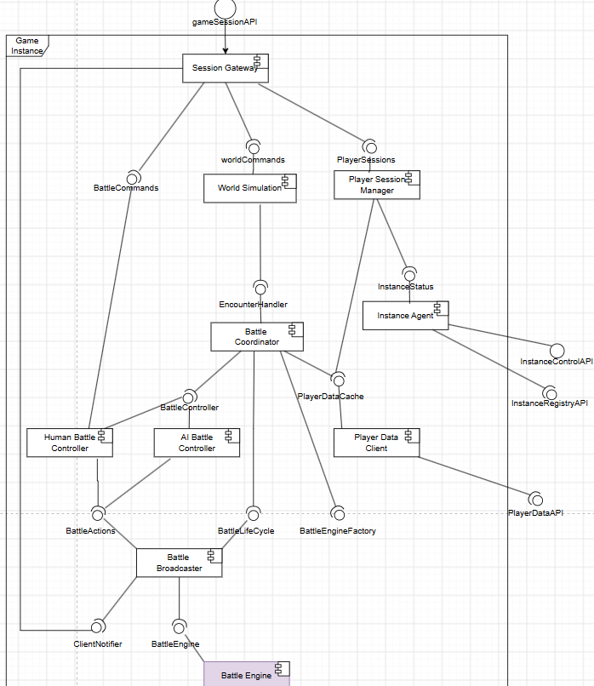
Read the design straight from the interfaces
C4 LAYER 3 · UML COMPONENT · §4.2
1 Battle Broadcaster provides BattleActions and BattleLifecycle (the two halves of BattleEngine) and requires BattleEngine (the real engine) and ClientNotifier (Session Gateway).
2 Both controllers require only BattleActions, so they cannot call nextTurn() or startBattle(). Interface Segregation, checked by the compiler.
3 Only the Battle Coordinator requires BattleLifecycle and BattleEngineFactory.
4 Human and AI both provide BattleController; the Coordinator requires that one interface (Strategy).
5 Same names as layer 2: the Instance Agent provides InstanceControlApi and requires InstanceRegistryApi; the Player Data Client requires PlayerDataApi; gameSessionAPI enters at the Session Gateway.
Notes:
This diagram is where you prove ISP and the decorator visually. Point 1: the decorator provides exactly what the engine provides, so callers cannot tell the difference. Point 2: the controllers literally cannot see nextTurn(). Point 5 is your C4 consistency argument: interfaces that cross the container boundary keep their layer-2 names.

Slide 24
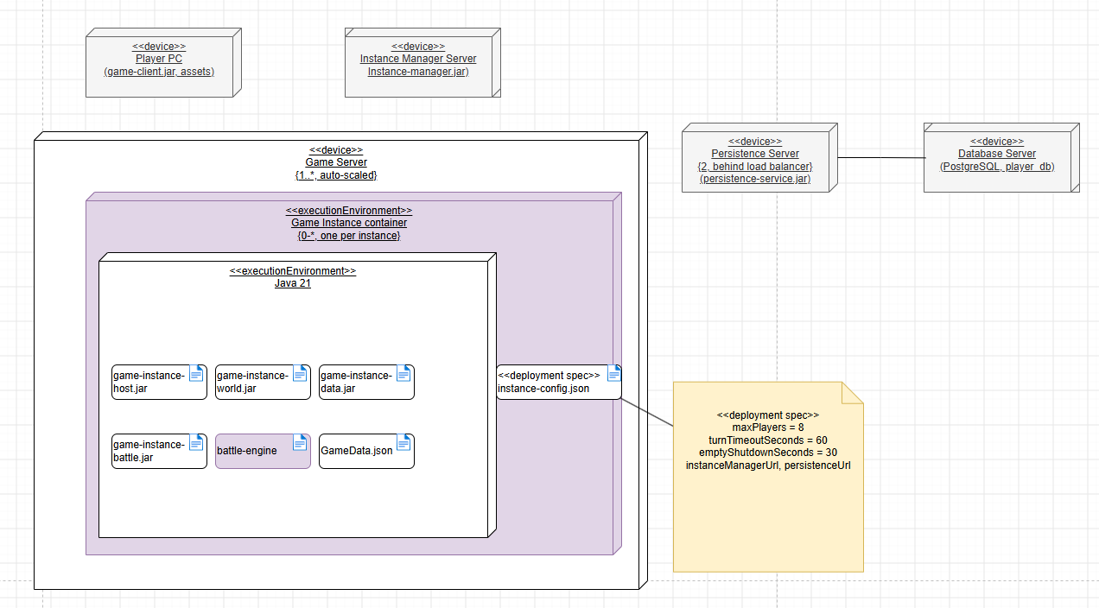
Inside one Game Instance container
C4 LAYER 3 · UML DEPLOYMENT · §4.3
Artifact → components
game-instance-host.jar: Session Gateway, Player Session Manager, Instance Agent
game-instance-world.jar: World Simulation
game-instance-battle.jar: Coordinator, both controllers, Broadcaster
game-instance-data.jar: Player Data Client
battle-engine.jar: the Battle Engine; depends on no other jar
GameData.json: enemy groups, encounter tables, action definitions
Persistence Server {2, behind load balancer}: stateless, so two copies keep it available; every instance needs it.
«deployment spec» instance-config.json: maxPlayers = 8, turnTimeoutSeconds = 60, emptyShutdownSeconds = 30, service URLs. Limits change without a new build.
Notes:
Say: “Layer 3 deployment zooms into the Game Server. A Game Instance container holds a Java 21 runtime with the instance’s jars and a deployment specification with the settings of that instance. The Battle Engine is a separate jar, used only by game-instance-battle.jar, and depends on no other jar of the game.” Why a deployment spec: the 8-player limit, the 60-second turn timer and the 30-second shutdown delay are settings, not code, so ops can change them without a new version. The {2, behind load balancer} only appears at layer 3: that is added detail, not a contradiction with layer 2.

Slide 25
One battle, from encounter to saved result
C4 LAYER 3 · DYNAMIC VIEW (SAY IT IN THIS ORDER)
1 · Encounter
2 · Build ConfigBattle
3 · Create, start
4 · Whose turn?
World Simulation detects enemies and calls the Battle Coordinator (EncounterHandler).
Party from the Player Data Client (memory). Stats include equipment, saved HP, actions of this level; enemies from GameData.
engineFactory.create() gives a new facade; the Broadcaster wraps it; startBattle(config).
Coordinator reads getBattleState() and lets the active player’s BattleController play the turn.
5 · Play
6 · End turn
7 · Battle over
8 · Save
Controller: getAvailableActions(unitId), pick targets, applyAction(). The Broadcaster pushes each change.
Human: “End turn” or the 60 s timer. AI: when it is done. Then the Coordinator calls nextTurn().
Status is FINISHED. The Coordinator calls getBattleLog(battleId).
XP, level-ups and remaining HP via the Player Data Client, written through to the Persistence Service.
These were two sequence diagrams in your earlier draft; the final PDF covers the flow in the text and tables of §4.1 and §7.2.
Notes:
This is your answer to “walk us through a battle”. Notice how every step has exactly one owner: the World Simulation detects, the Coordinator builds and loops, the controllers choose, the engine applies the rules, the Broadcaster informs the client, the Player Data Client saves. That is the single responsibility story at component level. Why does the Coordinator translate levels and equipment into numbers? So the engine never needs to know about levels or items: it gets plain Power, Defence, Spirit and HP.

Slide 26
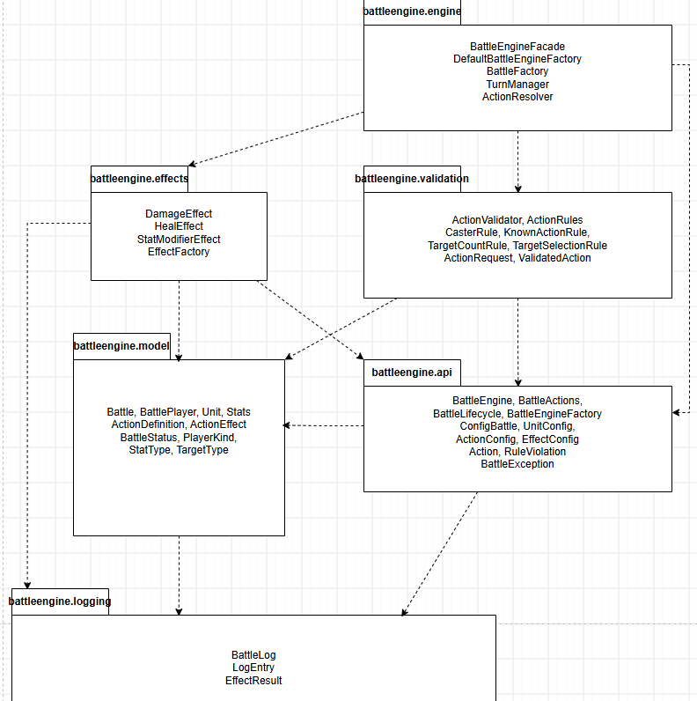
battle-engine.jar: six packages, no cycles
C4 LAYER 4 · CODE · §5.1
api · what other components use: BattleEngine, BattleActions, BattleLifecycle, BattleEngineFactory, ConfigBattle (+ Unit, Action, EffectConfig), Action, RuleViolation, exceptions.
engine · coordinates a battle: BattleEngineFacade, DefaultBattleEngineFactory, BattleFactory, TurnManager, ActionResolver.
validation · is this action allowed? ActionValidator, ActionRule and its 4 rules, ActionRequest, ValidatedAction.
effects · the formulas: DamageEffect, HealEffect, StatModifierEffect, EffectFactory.
model · state and invariants: Battle, BattlePlayer, Unit, Stats, ActionDefinition, ActionEffect (interface), enums.
logging · what happened: BattleLog, LogEntry and its subclasses, EffectResult.
All dependencies point down. ActionEffect is declared in model and implemented in effects, so model never depends on the concrete formulas (Dependency Inversion).
Notes:
Say: “Layer 4 is one jar, battle-engine.jar, with six Java packages. All dependencies point downwards, there are no cycles, and the model and logging packages do not depend on the packages that use them.” If they ask why packages: they group classes by responsibility (single responsibility at package level), and a dependency rule (only downwards) keeps the engine easy to change. Why is Action in api but ActionDefinition in model? Action is part of the public interface that callers build; ActionDefinition is internal state that callers never see.

Slide 27
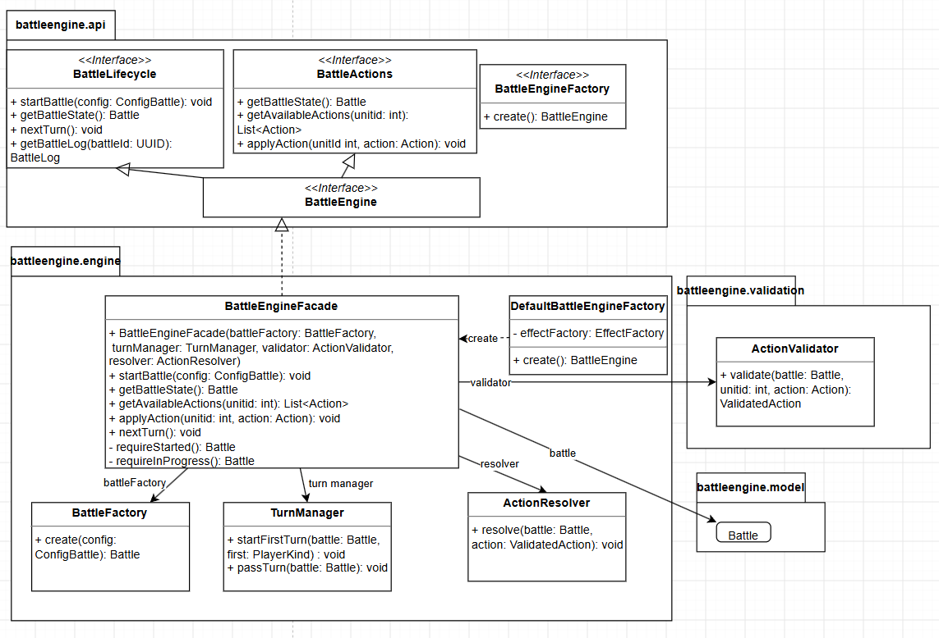
The interface and the facade
C4 LAYER 4 · CLASS DIAGRAM · §5.2
BattleEngine = BattleActions + BattleLifecycle: the six given methods, split by caller (ISP).
BattleEngineFacade is the only implementation. It hides BattleFactory, TurnManager, ActionValidator and ActionResolver (Facade).
Constructor injection of all four: testable with stubs (DIP).
Guards requireStarted() and requireInProgress(): a call in the wrong state throws.
DefaultBattleEngineFactory.create() wires a new engine per battle.
Figure gaps: getBattleLog() is missing in the facade box, and the realization arrow to BattleEngineFactory is not drawn.
Notes:
Say: “I split the six methods into two interfaces: BattleActions for the controllers and BattleLifecycle for the coordinator. Now the compiler stops a controller from calling nextTurn. BattleEngineFacade is the only implementation. It hides the factory, the turn manager, the validator and the resolver, so a caller does not need to know the order of the steps.” Notation in this figure: dashed line with hollow triangle = realization (a class implements an interface); solid line with hollow triangle = generalization (BattleEngine extends both interfaces); solid arrow = association (the facade holds a reference); dashed arrow «create» = dependency. If they spot the figure gaps: “The facade implements the whole BattleEngine interface, so getBattleLog is there; and DefaultBattleEngineFactory implements BattleEngineFactory. Those are omissions in the drawing.”

Slide 28
One engine per battle, not a Singleton
C4 LAYER 4 · YOUR HARDEST DECISION · §6.2, §7.2
The question hidden in the interface: nextTurn() and getBattleState() have no battleId, yet up to 8 players on one instance can be in a battle at the same time.
Option | Verdict
A · One engine per instance, add a battleId to every method | Rejected: changes the given interface.
B · A Singleton engine | Rejected: one battle per instance, and global state that tests would share.
C · One BattleEngineFacade per battle, from DefaultBattleEngineFactory | CHOSEN: the interface stays exactly as given, and battles cannot affect each other.
“But getBattleLog has a battleId?”
One object, without the pattern
Yes, the given signature has one. The facade checks it is the id of its own battle and refuses any other id.
The Game Instance startup code creates each factory once and passes it in. Tests can pass their own.
Notes:
This is the decision that best shows your process: reading the given interface carefully led to one engine object per battle, which led to the factory, the Battle Coordinator holding an engine per battle, and rejecting the Singleton. Extra, not in the PDF, if they ask about threads: messages from the network arrive on different threads, so the facade’s public methods can be synchronized; two calls on the same battle then never run at the same time, while different battles have different objects and never block each other. The battleId check on getBattleLog is also not written in the final PDF; it was in your earlier draft (an unknown id gives an error).

Slide 29
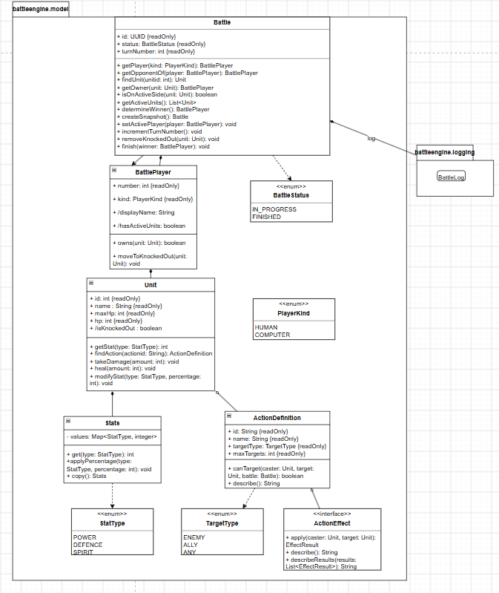
The battle model
C4 LAYER 4 · CLASS DIAGRAM · §5.3
Battle (the aggregate): id, status (IN_PROGRESS, FINISHED), turnNumber. Owns exactly 2 BattlePlayers and points to exactly 1 active player, so two turn rules of the case live in the structure itself.
BattlePlayer, not Player: “Player” already means the person in layers 1 to 3.
BattlePlayer has a number and a kind (HUMAN, COMPUTER) and owns its units in two lists: active and knocked out.
Unit guards 0 ≤ hp ≤ maxHp itself (takeDamage, heal); /isKnockedOut is derived from hp = 0.
Stats is a Map<StatType, Integer> (POWER, DEFENCE, SPIRIT): a new stat is a new enum value, not a new field.
ActionDefinition: id, name, TargetType, maxTargets and an ordered list of ActionEffects; canTarget(caster, target, battle).
Notation: filled diamond = composition (owned, same lifetime); open diamond = aggregation; {readOnly} = private field with getter; /name = derived.
Notes:
Say: “Battle owns exactly two BattlePlayers and points to exactly one of them as the active player. A BattlePlayer owns its units in two lists, active and knocked out. When a unit is knocked out it moves to the second list, so it can no longer act or be targeted.” Why is Unit responsible for its own HP limits? It is the information expert: it holds hp and maxHp, so it keeps the invariant itself and no caller can forget it. Why composition from Battle to BattlePlayer to Unit? They live and die with the battle. Why aggregation from Unit to ActionDefinition? Definitions come from configuration and describe what a unit can do; they are not created by the unit.

Slide 30
Nothing changes a battle outside the rules
C4 LAYER 4 · ENCAPSULATION · §5.3, §7.2, §7.3
getBattleState() returns a snapshot
Why model methods are public
Knocked-out units move to a second list
battle.createSnapshot() is a deep copy of players, units and log. It does not change while the caller reads it, and changing the copy changes nothing.
The effects, TurnManager and ActionResolver live in other packages, and Java has no C#-style “internal”.
They can’t act or be targeted, yet stay in the state and the log, so the state stays complete.
Still safe: only snapshots leave the facade, so outside code can never change a battle.
Rejected: deleting the unit (the state no longer shows who fell) and a flag only (every check must filter).
Rejected: the live Battle (callers could change HP without the rules); separate DTO classes (twice the classes).
Accepted: inside the engine, only the resolver, TurnManager and effects may change it.
Cost: one small copy per call, at most 8 units.
Notes:
Say: “getBattleState returns a deep copy, so no live object leaves the engine and every change goes through the rules.” If they ask “why not package-private?”: the classes that change the model sit in other packages (effects, engine), and Java’s package-private does not reach across packages. In your C# version (v1.0) you would have used internal; after the switch to Java, the snapshot is what protects the battle. That is a nice example of technology influencing the design.

Slide 31
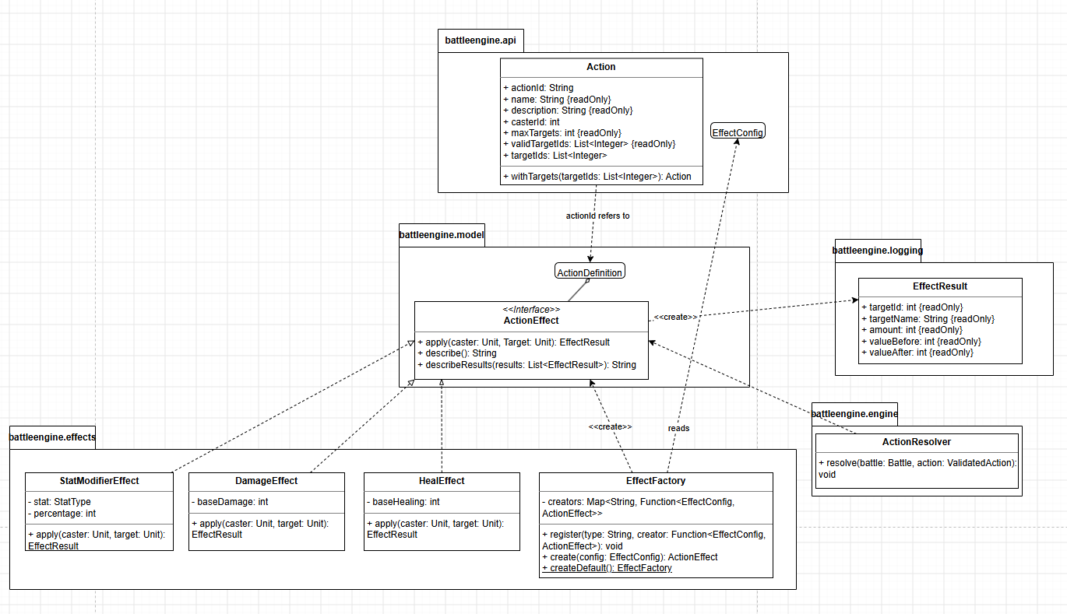
Actions: two classes for two different things
C4 LAYER 4 · CLASS DIAGRAM · §5.4
ActionDefinition (model) = what a unit can do: name, TargetType, maxTargets, list of effects. Built from config.
Action (api) = a request: actionId, casterId, targetIds, plus name, description, maxTargets and validTargetIds for the UI.
Why two: when actions are listed, no targets are chosen yet; and the client sends only ids, so values never come from it.
Server authority: a hacked client sending “9999 damage” changes nothing.
Rejected: one Action class with the effects and values inside.
getAvailableActions(unitId) → Action{validTargetIds} → action.withTargets(ids) → applyAction(unitId, action)
Notes:
Say: “ActionDefinition is what a unit can do; Action is only the request with ids.” Two problems solved by one split: (1) the case says the Action contains the targets, but getAvailableActions happens before targets are chosen, so the Action carries validTargetIds and the caller fills targetIds; (2) the server never trusts numbers from the client. Sources that back this: Gambetta (the server is the authority, clients send inputs, not results), Nystrom’s Command (both controllers produce the same request object) and Type Object (new kinds of actions are data, not subclasses).

Slide 32
Effects: Strategy plus a factory
C4 LAYER 4 · EFFECTS · §5.4, §6.2
ActionResolver calls effect.apply(caster, target) and gets an EffectResult, without knowing which effect it is.
// EffectFactory: type name → constructor
register("damage", c -> new DamageEffect(c.value))
DamageEffect(baseDamage)
register("heal", c -> new HealEffect(c.value))
max(0, base + power - defence)
register("modifyStat", c -> new StatModifierEffect(c.stat, c.value))
HealEffect(baseHealing)
create(effectConfig) → ActionEffect
base + caster.spirit, capped at maxHp
“Hit and lower Defence” needs no code: one ActionConfig with two EffectConfigs, damage 10 and modifyStat DEFENCE -25.
StatModifierEffect(stat, percentage)
ceil(old × (100 + p) / 100)
A new effect type (Poison, Gravity): one new class plus one register() call. Nothing else changes (Open/Closed).
Each effect writes its own log text
Rejected: an enum + switch in ActionResolver (every new type edits it), or one Action subclass per type (effects can’t be combined).
describeResults(): “did 3 damage to unit A and 4 damage to unit D”
Notes:
Say: “The effects use the Strategy pattern: damage, heal and stat change each implement ActionEffect. An action holds a list of effects, so an action like hit and lower defence needs no new code. The alternative, one Action class with a switch, changes with every new type.” EffectFactory.createDefault() (static, underlined in your diagram) registers the three built-in effects; the map is Map<String, Function<EffectConfig, ActionEffect>>. The code on this slide is an illustration of that map, not code from your PDF. Inspiration: RPG Maker MZ (a skill has a list of effects) and Unreal’s Gameplay Ability System (effects as data, including percentage changes).

Slide 33
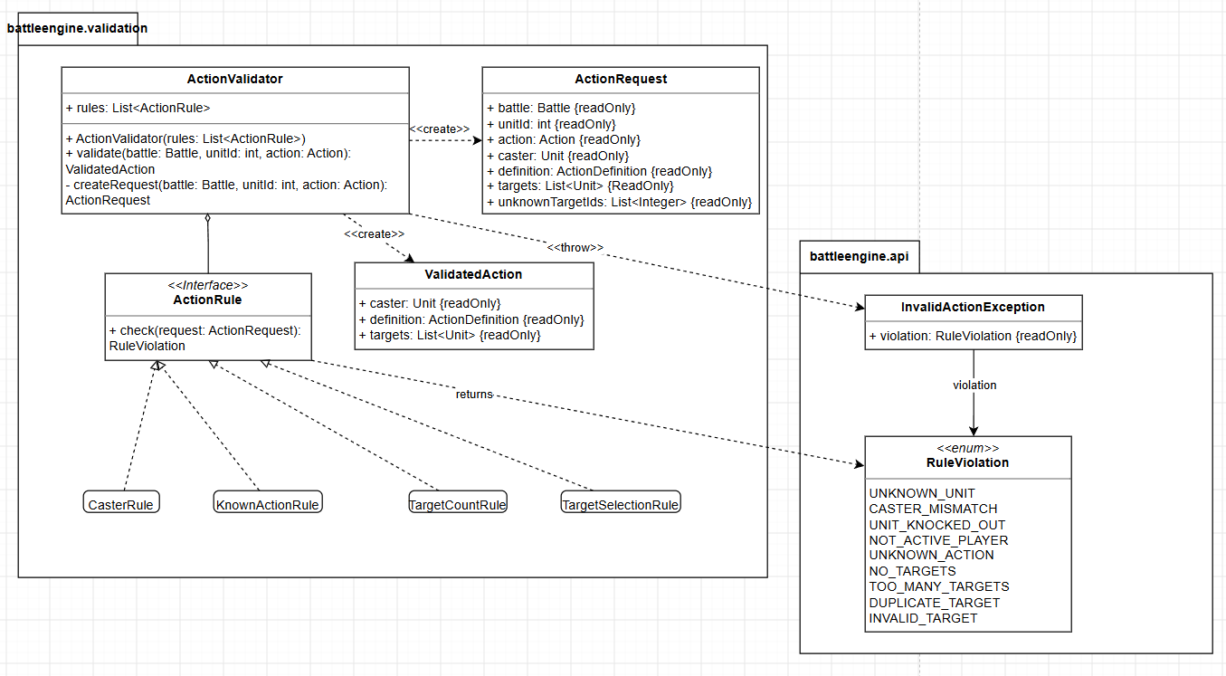
Validation: a list of small rules
C4 LAYER 4 · CLASS DIAGRAM · §5.5
4 rules · 9 violations
CasterRule: unit exists, casterId = unitId, not knocked out, on the active side
UNKNOWN_UNIT, CASTER_MISMATCH, UNIT_KNOCKED_OUT, NOT_ACTIVE_PLAYER
KnownActionRule: the caster has this actionId
UNKNOWN_ACTION
TargetCountRule: 1 ≤ targets ≤ maxTargets, no target twice
NO_TARGETS, TOO_MANY_TARGETS, DUPLICATE_TARGET
TargetSelectionRule: each target exists, is not knocked out, is not the caster, fits the TargetType
INVALID_TARGET
ActionValidator builds one ActionRequest, runs the rules in a fixed order and throws InvalidActionException at the first violation: nothing has changed. All pass → ValidatedAction → ActionResolver.
Notes:
Say: “applyAction first runs a fixed list of rules. The first violation throws an InvalidActionException, so a battle is never half changed. A new rule is one new class in the list.” Which case requirement does each rule enforce? CasterRule: only units of the active player can act, and the unitId must match the caster. KnownActionRule: the unit performs one of its own actions. TargetCountRule: 1..* targets, within the action’s maximum. TargetSelectionRule: knocked-out units cannot be targeted, the targets are other units, and the TargetType fits.

Slide 34
Fail fast here, collect all there
C4 LAYER 4 · VALIDATION CHOICES · §5.5, §5.6, §7.2
applyAction: fail fast
startBattle: collect all
Stops at the first violation and throws InvalidActionException with one RuleViolation.
BattleFactory checks the whole ConfigBattle and throws InvalidBattleConfigException with a list of all errors.
Why: the request comes from a player via a controller. One clear reason is enough to choose again, and the battle is never half changed.
Why: the config comes from game data and the Coordinator, so from developers. Every problem at once means one fix round (Fowler: notification).
Rules as objects in a list
ActionRequest, ValidatedAction
One exception family
Small, testable alone, explicit order. A new rule = a new class added in DefaultBattleEngineFactory. Rejected: one big validate() full of ifs.
Lookups happen once. The resolver only takes a ValidatedAction, so it can never get an unchecked action.
Errors extend BattleException (api), so a caller can catch one type, also for state errors like nextTurn() after the end.
Notes:
Likely question: “Isn’t the list of rules the Chain of Responsibility pattern?” Answer: it is close, but in Chain of Responsibility each handler knows the next one and decides to pass the request on. Here the ActionValidator owns the loop and the rules know nothing about each other; each rule is a small strategy-like object with one check(request) method. That keeps the order in one place (the factory). Likely question: “Why different error handling for config and actions?” Different callers with different needs: a player needs one reason, a developer fixing game data wants every error at once.

Slide 35
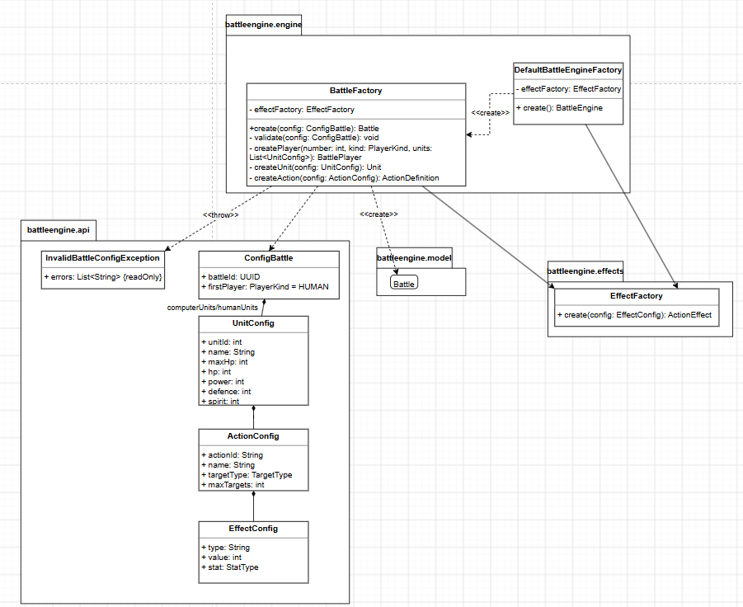
Configuration and factories
C4 LAYER 4 · CLASS DIAGRAM · §5.6
ConfigBattle = everything the engine needs: battleId (UUID), firstPlayer (default HUMAN), humanUnits and computerUnits, 1-4 each.
UnitConfig: unitId, name, maxHp, hp, power, defence, spirit and its ActionConfigs.
ActionConfig: actionId, name, targetType, maxTargets and its EffectConfigs.
EffectConfig: type (“damage”, “heal”, “modifyStat”), value, stat.
BattleFactory.create(config) validates the whole config first, then createPlayer → createUnit → createAction, using the EffectFactory.
hp next to maxHp: a character can start a battle hurt (its saved HP).
Plain numbers only: the Coordinator turned level and equipment into stats, and the config classes live in the engine’s own api, so the engine depends on nothing in the game.
Notes:
Say: “ConfigBattle contains everything the engine needs: the battle id, the player that starts and one to four units per player, each with HP, the three stats and its actions with their effects. The BattleFactory turns a ConfigBattle into a Battle. It first checks the whole configuration and collects all errors, so the caller sees every problem at once.” Notation in this figure: filled diamonds = composition (ConfigBattle owns its UnitConfigs, and so on down), dashed arrows «create» and «throw» = dependencies, solid arrows = associations (BattleFactory has an EffectFactory).

Slide 36
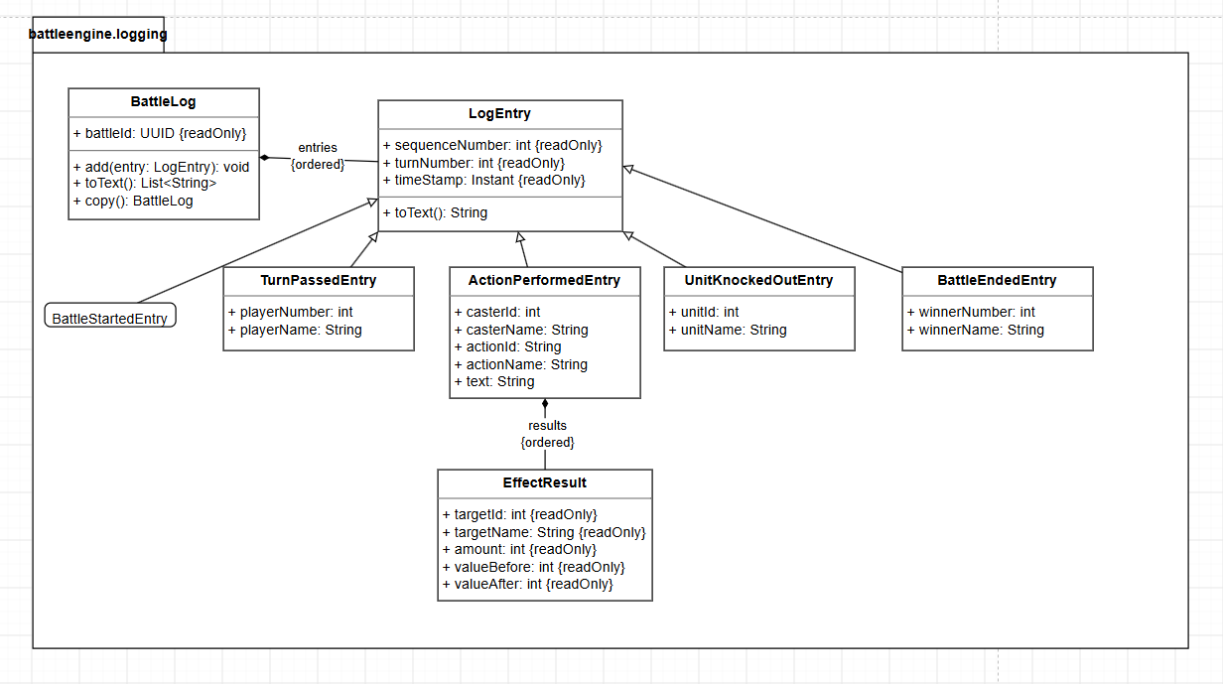
The battle log
C4 LAYER 4 · CLASS DIAGRAM · §5.7
getBattleLog(battleId).toText()
Battle starts
Turn passed to player 1 (Human)
Unit A uses Action X1 and did 15 damage to unit B.
Unit A uses Action X1 and did 12 damage to unit C.
Unit D uses Action X2 and heals unit A for 12.
Turn passed to player 2 (Computer)
Unit B uses Action X2 and did 3 damage to unit A and 4 damage to unit D.
Turn passed to player 1 (Human)
...
Unit C is knocked out
One LogEntry subclass per event (started, turn passed, action performed, knocked out, ended), each with its own toText().
Battle ends: player 1 (Human) wins
ActionPerformedEntry keeps the EffectResults (amount, before, after): the client uses them for animations and damage numbers.
Notes:
Say: “BattleLog is an ordered list of LogEntry objects. Every kind of event has its own subclass that describes itself in one line. The text of an action is written by the effects themselves, so a new effect type brings its own log text and nothing in the log has to change.” You checked your design against the example log of the case: it reproduces it line by line, plus the two lines your interpretations add (knocked out, battle ends). Rejected alternative: BattleLog builds the text with a switch on the effect type. Each entry also has sequenceNumber, turnNumber and timeStamp; BattleLog.copy() is used for the snapshot.

Slide 37
applyAction() and nextTurn(), step by step
C4 LAYER 4 · BEHAVIOUR (SAY IT IN THIS ORDER)
1
Facade requireInProgress(): the battle is started and not finished.
nextTurn()
2
ActionValidator.validate(): ActionRequest + 4 rules. A violation throws and nothing has changed.
requireInProgress(), then TurnManager.passTurn(): active = opponent, turnNumber + 1, TurnPassedEntry.
3
ActionResolver.resolve(): each effect in order, on every target that is still active, gives an EffectResult per target.
Not started
4
One ActionPerformedEntry with all EffectResults goes into the log.
↓ startBattle()
5
Every target at 0 HP moves to knockedOutUnits, with a UnitKnockedOutEntry.
In progress: HumanTurn ↔ ComputerTurn
6
A side with no active units: battle.finish(winner), status FINISHED, BattleEndedEntry.
↓ last unit of a side knocked out
Finished
One effect goes to all targets before the next effect, so the log reads “did 3 damage to unit A and 4 damage to unit D”.
nextTurn() switches between the two turn states. A call in the wrong state throws.
Notes:
The sequence diagram of applyAction and the state machine of the facade were in your earlier draft, not in the final PDF. The behaviour is still described in your text (5.5, 5.7) and decisions (7.2). This slide is your answer to “What happens exactly when the AI calls applyAction?”. Two small details that impress: (1) validation is complete before anything changes, so a battle is never half changed; (2) the knock-out check and the end-of-battle check happen inside applyAction, so the engine itself decides when the battle is over.

Slide 38
SOLID: where each principle lives
SOLID AND PATTERNS · §6.1
S
Single responsibility
Facade coordinates, TurnManager turns, rules allow, resolver executes, effects calculate, BattleLog records.
A new damage formula only touches DamageEffect.
O
Open/Closed
New ActionEffect + register(), new ActionRule in the list, new BattleController, new LogEntry, decorators.
The rules grow without editing tested classes.
L
Liskov substitution
Every ActionEffect returns an EffectResult, every ActionRule only reads, every LogEntry gives one line.
Resolver, validator and log never check the concrete type.
I
Interface segregation
BattleEngine split into BattleActions and BattleLifecycle; ActionRule and ActionEffect are tiny.
A controller cannot call nextTurn(): the compiler stops it.
D
Dependency inversion
Constructor injection in the facade; the Coordinator depends on interfaces; ActionEffect declared in model, built in effects.
Every part can be tested with stubs.
Notes:
One-line definitions to have ready. S: a class has one reason to change. O: open for extension, closed for modification (add new classes instead of editing old ones). L: a subtype can replace its base type without the caller noticing. I: clients should not depend on methods they do not use. D: high-level code depends on abstractions, not on concrete classes; the abstraction is owned by the high-level side (that is why ActionEffect is declared in model, not in effects). Outside the engine, SRP also explains the layer-3 split: networking is in the Broadcaster, persistence in the Player Data Client.

Slide 39
Patterns, and the alternative you rejected
SOLID AND PATTERNS · §6.2
Pattern | Where | Problem it solves | Rejected alternative
Facade | BattleEngineFacade | Callers need six simple methods, not four classes and their order | Callers use the four classes directly and must know the order
Strategy | ActionEffect: Damage, Heal, StatModifier | Each effect type has its own formula | Enum + switch in ActionResolver: every new type edits it
Strategy | BattleController: Human, AI | Same turn loop; only who chooses differs | if/else on the player kind in the Coordinator
Factory | DefaultBattleEngineFactory, BattleFactory, EffectFactory | Complex construction belongs in one place | new everywhere: construction knowledge spread out
Decorator | Battle Broadcaster | Push every change to the client while the engine knows no networking | The engine sends updates itself: a second responsibility
Singleton | Considered for the facade | One global engine, reachable from everywhere | REJECTED: one battle only and global state; instead one object per battle
Notes:
The rubric’s top band says “design patterns are justified”: for each one, say the problem first, then the pattern, then the rejected alternative. Example for Strategy: “There are three kinds of effects, and there will be more, each with its own formula. So ActionEffect is an interface with one class per effect, and the resolver calls apply without knowing which one it is. I considered one Action class with an enum and a switch, but every new effect type would change that switch.” Your presentation’s takeaway fits here: use a pattern only where the behaviour really differs.

Slide 40
What makes each pattern the real thing
SOLID AND PATTERNS · IF THEY DIG DEEPER
Facade
Strategy
Decorator
A simple front for a subsystem. Test: callers never touch TurnManager, validator or resolver; only the facade knows the order (check, then apply).
Interchangeable algorithms behind one interface. Test: the resolver calls apply() on any effect; the Coordinator uses either player’s controller.
Same interface as the object it wraps, adds behaviour, callers can’t tell. Test: the Broadcaster implements both halves, forwards, then notifies.
Factory, precisely
Not a Singleton
From your sources
BattleEngineFactory + its Default class: a factory interface (closest GoF: Abstract Factory, one product). BattleFactory and EffectFactory: simple factories.
Startup code creates each factory once and passes it in (dependency injection): one object, no global access, tests pass their own.
Action works like a Command: both controllers make it, one engine runs it. ActionDefinition is a Type Object: new actions are data.
Notes:
Be careful with words. Do not call EffectFactory an “Abstract Factory”: it is a registry that maps a type name to a creator function. If asked “why is the Broadcaster not just an Observer?”: an observer would need the engine to publish events, which puts notification code in the engine; the decorator keeps the engine completely unaware, and callers still use the same interface. If asked “is the facade also a Mediator?”: no, the facade only simplifies access; the classes behind it do not talk to each other through it.

Slide 41
What-if questions prove it is expandable
SOLID AND PATTERNS · “EXPANDABLE” IN THE RUBRIC
What if… | What you add or change | What stays untouched
A new action “hit and lower Defence” | Only data: one ActionConfig with a damage and a modifyStat effect | All code
A new effect type (Poison, Gravity) | One new ActionEffect class and one register() call | Resolver, facade, validation, log
A new stat (Speed) | A new StatType value and a field in UnitConfig | Stats, effects, rules
Each unit may act once per turn | New OneActionPerUnitRule; Battle remembers who acted; passTurn() clears it | Validator, resolver, the interface
Auto-battle (AI plays for you) | The Coordinator uses the AI controller for the human side | The whole engine
Effects that last several turns | Be honest: a model change, active effects on Unit and a hook in passTurn() | Interface, validation, existing effects
Notes:
One more if asked: the log in another language. toText() moves to a formatter per language; the entries already store their data, so the log’s data model stays the same. The honest row (effects over several turns) is a strength, not a weakness: showing where your design would need a change proves you understand it. Say: “That needs a small model change: a unit keeps a list of active effects, and the TurnManager applies them in passTurn. The interface and the validation stay the same.”

Slide 42
How you arrived at this design
PROCESS · §7.1 · “HOW DID YOU ARRIVE AT THIS DESIGN?”
1
The given interface first: six methods and an engine that only runs the rules. Everything else is built around it.
Higher layers set limits for lower ones
L2 instance is memory-only and stops when empty → L3 engine has no storage; the Coordinator saves.
2
Context: what is in the system and what is not (one system, one external Account Provider).
3
Containers: split by how the game is played. Each container its own reason, each connection a fitting protocol.
L2 up to 8 players fight at once → L4 one facade per battle, no Singleton.
4
Components: place the engine between its users: who starts, who chooses, who passes the turn, who saves.
L3 only the Coordinator starts and passes turns → L4 interface split in two.
5
Code: interface and facade first, then model, actions and effects, validation, config, log.
6
Check: SOLID; a pattern only where behaviour really differs, each with a rejected alternative; and the case’s example log.
Same names on every layer; purple marks what the next layer zooms into.
Notes:
This is the answer to the first question the workbook lists: “How did you arrive at this design?” Say: “I designed top-down through the four C4 layers, starting from the given interface. Decisions on a higher layer set the limits for the lower layers. For example, because an instance keeps data only in memory and stops when empty, the engine has no storage and the Coordinator saves the results. Because up to eight players can fight at once, every battle gets its own engine object. And because only the Coordinator may pass the turn, I split the interface in two. Finally I checked the design against SOLID, chose patterns only where behaviour really differs, and checked that the log reproduces the example of the case.”

Slide 43
How the design changed over time
PROCESS · ITERATIONS (NOT IN THE FINAL PDF, BUT TRUE)
v0.1 · 23 Sep
Review · 7 Oct
v1.0 · 8 Oct
v1.1 → final
Goal, first diagrams. Layer 3 had a session controller, an AI controller, the engine, and a persistence client the engine called itself.
Checked against case and rubric: wrong UML symbols, no C4 notation, names differing per view, instance rules missing, no layer 4.
Coordinator saves results, so the engine has no dependencies. One name per element. Layer-3 boundary and interfaces. Full layer 4.
C#/.NET + Unity became Java 21; Java naming; snapshots instead of C# internal; diagrams redrawn and simplified.
Insight 1
Insight 2
Insight 3
The given interface hides a design question: no battleId on nextTurn() led to one engine per battle.
A small engine makes the rest easier: turn loop, updates and saving each got one clear place.
Two Action classes solved two problems: no targets yet, and never trust numbers from the client.
Notes:
The examiners “assess not only the result, but also the design process”. These changes are your evidence. Best story: “In my first version the Battle Engine called a persistence client itself. When I compared it with my own goal, that the engine knows nothing about the rest of the game, it contradicted it. So I moved saving to the Battle Coordinator, and the engine ended up with zero dependencies.” Renames along the way: session controller became the Human Battle Controller, AI controller the AI Battle Controller, persistence client the Player Data Client. Why Java: it is the course language, and one language lets client and server share data classes. Why simplified diagrams: you kept only what you can explain and what serves the reader.

Slide 44
Trade-offs: say them before they do
PROCESS · §7.3 TRADE-OFFS
A battle lives only in memory
Model methods are public
A crash loses the running battle. Fine: only the results (XP, levels) must be kept, and the Coordinator saves them right after the battle.
Engine code could skip the rules, so only the resolver, TurnManager and effects change a battle. From outside it is impossible: only snapshots leave.
A deep copy per state read
More classes
Some memory and CPU per getBattleState() call, but a battle has at most 8 units and one log, so the copy is small.
Every rule, effect and log entry is a class. In return each one is small, testable on its own, and adding one changes nothing that exists.
Two more if asked: write-through costs a network call per change (fine: changes are rare and progress must never be lost); the 30 s shutdown delay keeps an empty instance alive a little longer.
Notes:
Naming a trade-off yourself scores better than having it pointed out. If they ask “isn’t this over-engineered?”, use card 4: “It has more classes than one big class with a switch. In return every class is small and testable, and the rules of the game will grow: new effects and rules are new classes, not edits. I only used patterns where the behaviour really differs, and I rejected the Singleton.”

Slide 45
What inspired what
PROCESS · §8 SOURCES
Source | Idea | Used in
Pokémon Showdown (Smogon) | A separate battle simulator: lists choosable moves, rejects an invalid choice, logs events | getAvailableActions, validated applyAction, BattleLog
RPG Maker MZ | A skill has a scope (enemy or ally, number of targets), a stat formula and a list of effects | ActionDefinition: TargetType, maxTargets, effects
Nystrom: Type Object, Command | New kinds in data, not subclasses; input and AI make the same command object | ActionDefinition from config; one Action for both
Gambetta | The server is the authority; clients send inputs, not results | Action carries only ids
AWS GameLift, Agones | A server process reports ready, has limited slots, runs in its own container | Instance Manager, Instance Agent, max 8
AWS caching, Fowler | Write-through is never stale; report all validation errors at once | Player Data Client; BattleFactory
Notes:
Also in your list: Unreal’s Gameplay Ability System (effects change attributes, also by a percentage, and are data assets: StatModifierEffect and effects from configuration), MDN on WebSocket (two-way without polling), Simon Brown’s C4 model and the OMG UML 2.5.1 spec (your notation), and Refactoring.Guru for the five patterns. If asked “where did the idea for X come from?”, naming a real game engine shows you did research rather than inventing in a vacuum.

Slide 46
Defence drill
PART 9
Weak spots first, then the likely questions, then two cheat sheets. Answer every question with the same four beats:
Decision
→
Reason
→
Rejected alternative
→
Where in the PDF
Notes:
Example in four beats. Q: “Why is the Battle Broadcaster a decorator?” Decision: it implements the same BattleActions and BattleLifecycle interfaces as the engine and wraps it. Reason: after every change it pushes the new state to the client, so the engine stays free of networking. Rejected: the engine sends updates itself, which gives it a second responsibility, or each of the three callers sends updates, which copies the same code three times. Where: sections 4.1 and 6.2.

Slide 47
Notation slips, and what to say
DEFENCE DRILL · WEAK SPOTS (1 OF 2)
Don’t defend a notation error. Name the correct notation, then say what you meant.
Where | What they may notice | Your answer
§2.2 | Use cases are rectangles; associations have arrowheads | “In UML a use case is an oval inside the boundary, and an association is a plain line. Each box is one actor goal, so the meaning is what I intended.”
§2.3 | Apply → Validate is a solid, unlabelled arrow | “It should be a dashed arrow labelled «include», from Apply action to Validate action, because validation always happens.”
§4.1 | Engine box says “[Container: Java library]” | “At layer 3 it is a component of the Game Instance, deployed as a library jar. The label should say Component.”
§5.2 | getBattleLog() missing in the facade box; no realization to BattleEngineFactory | “The facade implements the whole BattleEngine, so getBattleLog is there, and DefaultBattleEngineFactory implements BattleEngineFactory. Drawing omissions.”
Notes:
Tone matters: calm, short, no excuses. “Good catch. In UML that should be X. What I meant is Y.” Then move on. Examiners mostly want to see that you know the notation, which you do. Your earlier draft even stated this insight: notation is part of the design, because the wrong symbol says something you did not mean.

Slide 48
Gaps in content, and how to cover them
DEFENCE DRILL · WEAK SPOTS (2 OF 2)
Where | What they may notice | Your answer
Whole PDF | No sequence or state diagrams in the final version | “The flow is in my text and tables; let me walk you through it.” Then use slides 25 and 37.
Layer 4 | Few UML notes on the class diagrams (the workbook asks for them) | “The choices are explained under each diagram and in 7.2. Next time I’d put the key ones as notes on the diagram.”
§1.2 | Self-targeting and rounding not in the table | “No self-target: ‘1..* other units’, checked by TargetSelectionRule. Rounding: always up, also for decreases.”
§4.3 | Persistence Server {2, behind load balancer} only at layer 3 | “Layer 3 adds detail: the service is stateless, so two copies behind a load balancer keep it available.”
Whole PDF | No requirement IDs or traceability table | “Every case rule maps to a component or class.” Then use slides 6 and 8.
Notes:
None of these is fatal. The rubric’s C4 and UML rows look at correct and consistent use, and your layers are consistent: same names on every layer, purple marks the zoom, container interfaces reappear at layer 3. Lead with that strength if they push on a gap: “The diagrams are consistent across all four layers; this specific symbol is wrong, it should be X.”

Slide 49
Architecture: layers 1 to 3
DEFENCE DRILL · LIKELY QUESTIONS (1 OF 3)
Why is the engine a library, not a service?
How do you guarantee max 8 players?
A battle belongs to one instance and lives in memory. A service adds a network call per action and a second place with state, and gains nothing.
The Instance Manager checks its registry before routing, and the instance checks again on join, because two visitors can be routed at the same moment.
What happens to a battle when an instance crashes?
It is lost, and that is accepted: only results must be kept, and they are saved right after the battle. Player data is written through, so nothing else is lost.
Why is the AI not an actor at layer 1?
It runs on our servers, so it is inside the system. In the Battle Engine use case diagram it is an actor, because there the engine is the subject.
Why WebSocket and not REST for the client?
How does the instance check the access token?
The server must push the computer’s moves and other players’ movement; REST would need polling. UDP is not needed for turn-based play.
The Session Gateway checks it on join. A signed OAuth token can be verified locally with the provider’s public key, without a call.
Notes:
Practise these out loud, not just in your head. Keep each answer to two or three sentences; if they want more, they will ask. For the crash question, add the trade-off framing: “I accepted that, because storing a half-finished battle would mean permanent data on or for an instance, which the case rules out.”

Slide 50
Layer 4 and the patterns
DEFENCE DRILL · LIKELY QUESTIONS (2 OF 3)
Why split BattleEngine into two interfaces?
How do you add a new kind of action?
Interface Segregation: controllers need actions, the Coordinator needs the lifecycle. A controller can’t call nextTurn(); the compiler stops it. BattleEngine still has all six.
A new effect type: one ActionEffect class and one register() call. A combination of existing effects needs no code, only config.
Why separate Action and ActionDefinition?
Why not a Singleton engine?
Actions are listed before targets are chosen, and the client may only send ids. Values come from the engine, so a modified client can’t cheat.
Up to 8 battles run at once on one instance and nextTurn() has no battleId. A Singleton allows one battle and is global state that tests would share.
What happens on an invalid action?
The first failing rule throws InvalidActionException with a RuleViolation, e.g. NOT_ACTIVE_PLAYER; nothing changed. After the end, requireInProgress() throws.
Why does getBattleState() return a copy?
With the live object a caller could change HP without the rules. The copy stays consistent while you read it, and it is small.
Notes:
For the Singleton question, add the positive half: “Instead, the startup code of the Game Instance creates the factories once and passes them in, so there is one factory object without the Singleton pattern.” For the invalid action: the Human Battle Controller catches the exception and shows the reason, and the player picks again; the AI controller should only pick from getAvailableActions, so it should never trigger one.

Slide 51
Process and curveballs
DEFENCE DRILL · LIKELY QUESTIONS (3 OF 3)
What would you do differently?
How would you test the engine?
Real UML ovals and a dashed «include»; the sequence and state diagrams back in; key choices as notes on the class diagrams; a traceability table.
No server needed: startBattle with a small ConfigBattle, apply actions, assert on getBattleState() and the log. Each rule and effect alone, with stubs.
What was the hardest decision?
One engine per battle. nextTurn() has no battleId, yet 8 players can fight at once. That led to the factory, the Coordinator and no Singleton.
Can a unit heal itself?
Not here: the case says “1..* other units”, so TargetSelectionRule rejects the caster. Self-heal = a new TargetType value plus a change to that one rule.
Isn’t this over-engineered?
More classes than a switch, but each is small and testable, and the rules will grow. Patterns only where behaviour differs; I rejected the Singleton.
Why Java, when you started in C#?
Java is the course language, so it can be built with what we learned, and one language lets client and server share data classes.
Notes:
If you get a question you really cannot answer: say what you would check and where in your design the answer would live (“That would be decided in the TurnManager; I did not specify it, but I would…”). Never invent a detail and claim it is in the PDF.

Slide 52
C4 and UML notation in one page
CHEAT SHEET 1 OF 2
C4
UML
L1 Context: the system as one box, its people and external systems.
Use case: actor, oval, system boundary, plain-line association. «include» = always, dashed from base to included. «extend» = sometimes, dashed from extension to base.
L2 Container: things that run or store data on their own: apps, services, databases. Not Docker.
L3 Component: a group of code behind an interface, inside one container.
Component: ball = provided, socket = required.
Deployment: «device», «executionEnvironment», «artifact», «deployment spec».
L4 Code: classes, as UML class diagrams.
Rules: each box has a name, [type: technology] and a description; each arrow says what happens plus [protocol]; a legend; the same names on every layer.
Class: + public, - private, {readOnly}, /derived, underlined = static.
Lines: generalization = solid + hollow triangle; realization = dashed + hollow triangle; dependency = dashed arrow; composition = filled diamond; aggregation = open diamond.
Notes:
Two definitions examiners like to test. Container vs component: a container is separately deployable or runnable (it has its own process or storage); a component is a part of one container with a clear interface, not separately deployable. Composition vs aggregation: with composition the part lives and dies with the whole (a Unit inside its BattlePlayer); with aggregation the part can exist on its own or be shared (an ActionDefinition from configuration).

Slide 53
Numbers to have ready
CHEAT SHEET 2 OF 2
6
2
5
10
6
methods in the given interface
halves: BattleActions, BattleLifecycle
containers at layer 2
components in the Game Instance
packages in battle-engine.jar
4
3
5
5
13
validation rules, 9 violations
effect strategies: damage, heal, stat
LogEntry subclasses
patterns used, Singleton rejected
rows in the decisions table (7.2)
8
60 s
30 s
1-4
2
max players per instance
turn timer
empty-instance shutdown delay
units per side
BattlePlayers, exactly 1 active
Notes:
The ten components: Session Gateway, Player Session Manager, Instance Agent, World Simulation, Battle Coordinator, Human Battle Controller, AI Battle Controller, Battle Broadcaster, Battle Engine, Player Data Client. The six packages: api, engine, validation, effects, model, logging. The five patterns: Facade, Strategy (twice: effects and controllers), Factory, Decorator, plus Singleton considered and rejected. The five log entries: BattleStarted, TurnPassed, ActionPerformed, UnitKnockedOut, BattleEnded.

Slide 54

Tonight and tomorrow morning
LAST SLIDE
Laptop ready: “RokasPazera551495 exam1.pdf”, the TD2 PDF, the EA2 code, your reflections and your presentation.
Tomorrow morning, 10 minutes
Your EA1 part of the presentation: slides 2 to 7, about 3:35 (context 35 s, containers 45 s, components 40 s, facade 45 s, effects and validation 40 s).
Slide 3 · the story
Slide 4 · five ideas
Out loud, twice: the 60-second story (slide 3) and the five ideas (slide 4).
Slide 21 · three layer-3 decisions
Slide 28 · one engine per battle
Drill: the weak spots (slides 47 and 48) and the 18 questions (slides 49 to 51), out loud.
Slides 47-48 · weak spots
Slide 53 · numbers
Both TDs open side by side: questions can jump between EA1 and EA2.
Don’t know? Say where in the design it would live and how you would decide. Never invent a detail.
You know this design. Every choice has a reason and a rejected alternative, and the layers line up. Say it calmly.
Notes:
The deck covers EA1 only. EA2 (the 3D print scheduler) is in your talking script and presentation: remember they will ask you to show the refactored code, so have the project open and know where selectPrintTask, canPrint and the PrintStrategy interface are.

